Slide 1
Evaluating Machine Learning Models
Content created by: Mélanie Roschewitz, Pau de Jorge, Chen Chen, Owais Hussain

Slide 2
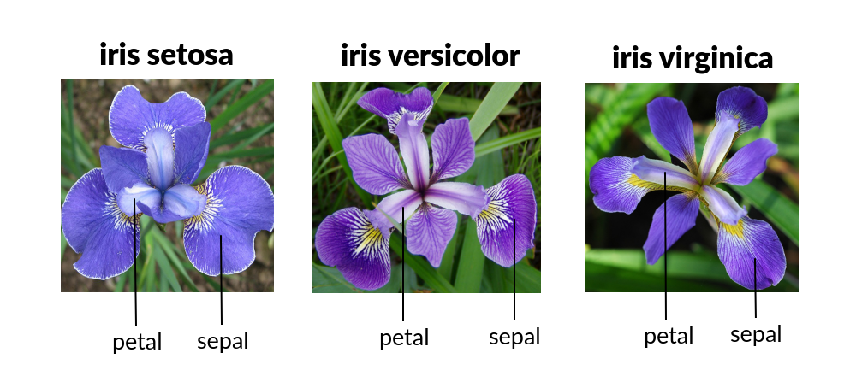
Recap…
We have learned to create Linear models for both Regression and Classification.
We used MSE and Binary Cross-Entropy to measure how good our models are.
The famous Iris dataset was used for both type of models.
Today, we take a deep dive into how to evaluate our models for real-world use cases.

Slide 3
Evaluating a model

Slide 4
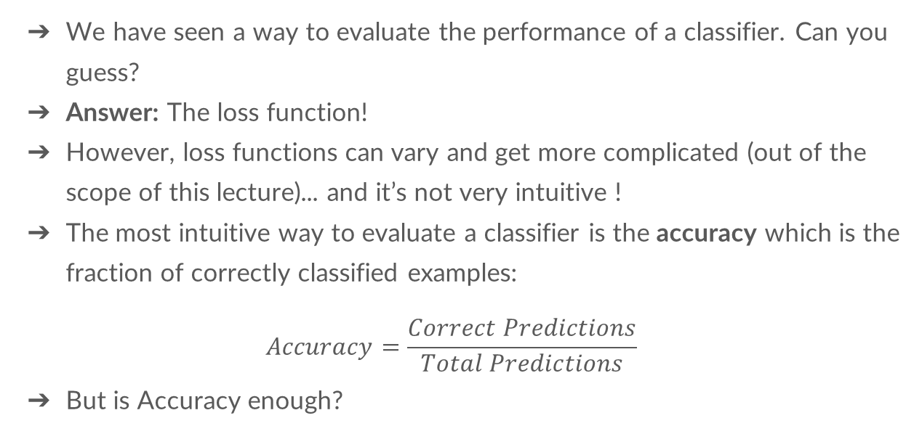
Evaluating a classifier
We have seen a way to evaluate the performance of a classifier. Can you guess?
Answer: The loss function!
However, loss functions can vary and get more complicated (out of the scope of this lecture)... and it’s not very intuitive !
The most intuitive way to evaluate a classifier is the accuracy which is the fraction of correctly classified examples:
$$Accuracy=\frac{Correct Predictions}{Total Predictions}$$
But is Accuracy enough?

Slide 5
High Accuracy trap
Case 1: National security force wants to install a radar which detects unauthorized aircrafts in the airspace.
Case 2: Health ministry wants to classify high-risk, potentially cancerous people for a new preventive therapy that has serious side effects.
Case 3: An academic grant is awarding scholarships to study abroad, only to candidates who are likely to finish their degree.
Which one is the right metric for these cases?
Notes:
Recall (Sensitivity)
Precision

Slide 6
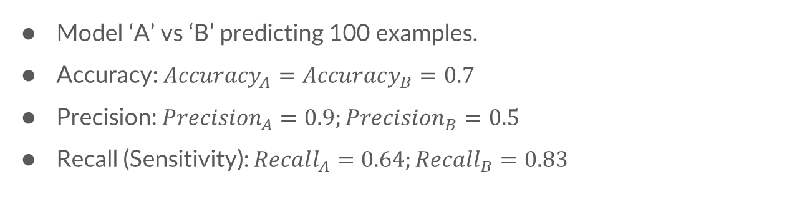
Choosing the right metric
Model ‘A’ vs ‘B’ predicting 100 examples.
Accuracy: $Accuracy_{A}=Accuracy_{B}=0.7$
Precision: $Precision_{A}=0.9;Precision_{B}=0.5$
Recall (Sensitivity): $Recall_{A}=0.64;Recall_{B}=0.83$
Model ‘A’ |  |  | Model ‘B’
 | Positive | Negative |  | Positive | Negative
Positive | 45 | 5 | Positive | 25 | 25
Negative | 25 | 25 | Negative | 5 | 45
Notes:
Model ‘A’ does not call it positive until it is very confident.
The high-risk cancer procedure should have high precision, even if it means it will reject some of the actual cancer patients.

Slide 7
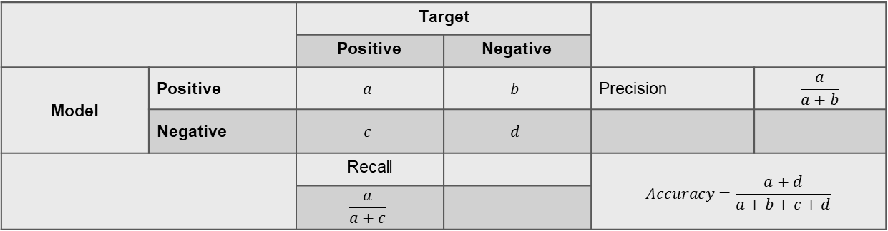
Confusion Matrix
Accuracy: correct predictions
Precision: of all examples predicted as Positive, how many were really positive?
Recall: of all Positive examples, how many were identified?
 |  | Target
 |  | Positive | Negative
Model | Positive | $$a$$ | $$b$$ | Precision | $$\frac{a}{a+b}$$
 | Negative | $$c$$ | $$d$$
 |  | Recall |  | $$Accuracy=\frac{a+d}{a+b+c+d}$$
 |  | $$\frac{a}{a+c}$$

Slide 8
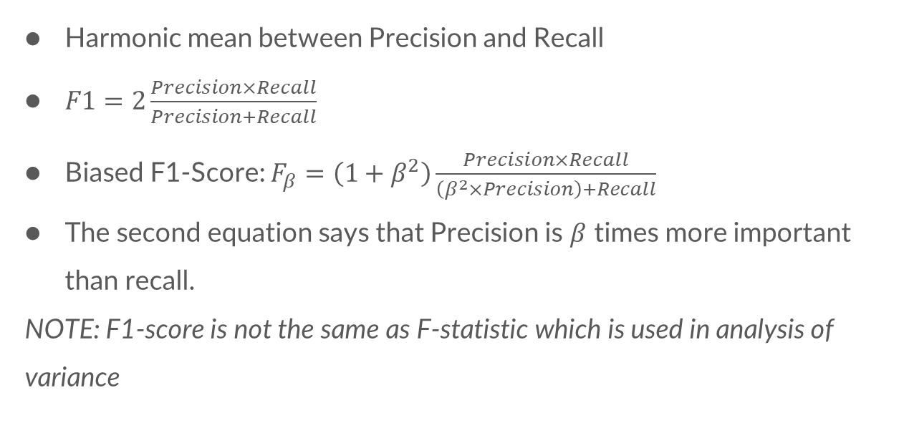
F1-Score
Harmonic mean between Precision and Recall
$F1=2\frac{Precision×Recall}{Precision+Recall}$
Biased F1-Score: $F_{β}=\left(1+β^{2}\right)\frac{Precision×Recall}{\left(β^{2}×Precision\right)+Recall}$
The second equation says that Precision is $β$ times more important than recall.
NOTE: F1-score is not the same as F-statistic which is used in analysis of variance

Slide 9
99% Accuracy Trap
Trap: “My model is 99% accurate. I shouldn’t need other metrics”.
Case 4: Airport Security requires a model, which can detect arms in luggage.
The problem? In real world, 999 out of 1000 passengers will not be carrying a weapon luggage.
Meaning if your model Predicts them all as Negative, it will still be 99.9% Accurate.

Slide 10
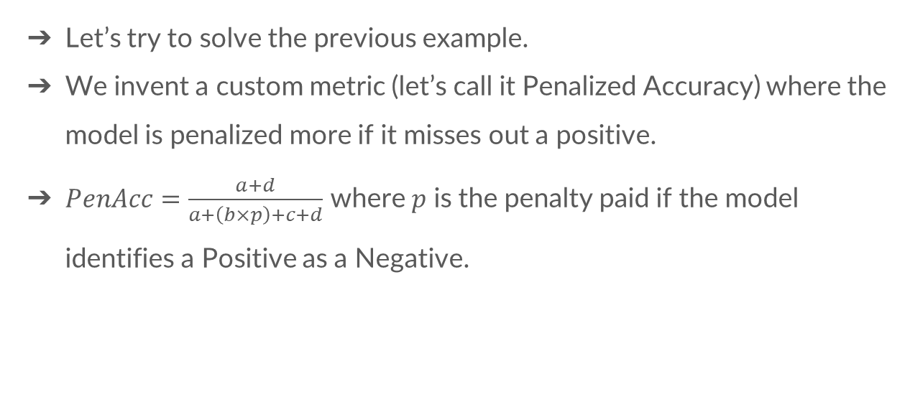
Custom Metrics
Let’s try to solve the previous example.
We invent a custom metric (let’s call it Penalized Accuracy) where the model is penalized more if it misses out a positive.
$PenAcc=\frac{a+d}{a+\left(b×p\right)+c+d}$ where $p$ is the penalty paid if the model identifies a Positive as a Negative.

Slide 11
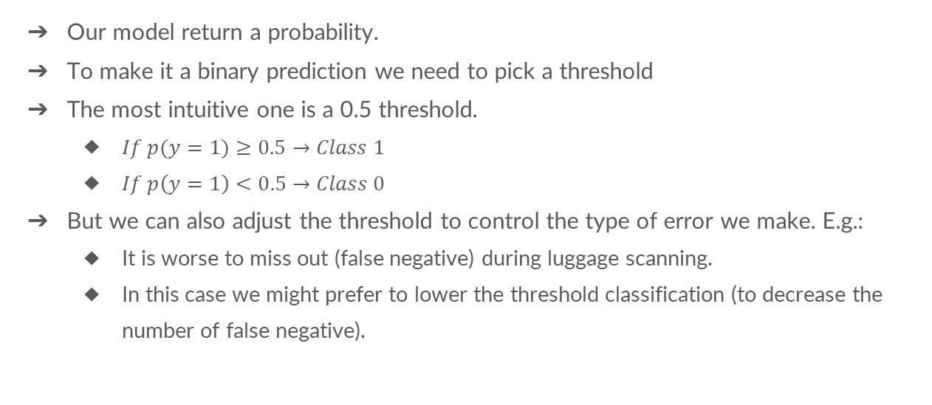
The role of the classification threshold
Our model return a probability.
To make it a binary prediction we need to pick a threshold
The most intuitive one is a 0.5 threshold.
$If p(y=1)≥0.5→Class 1$
$If p\left(y=1\right)<0.5→Class 0$
But we can also adjust the threshold to control the type of error we make. E.g.:
It is worse to miss out (false negative) during luggage scanning.
In this case we might prefer to lower the threshold classification (to decrease the number of false negative).

Slide 12
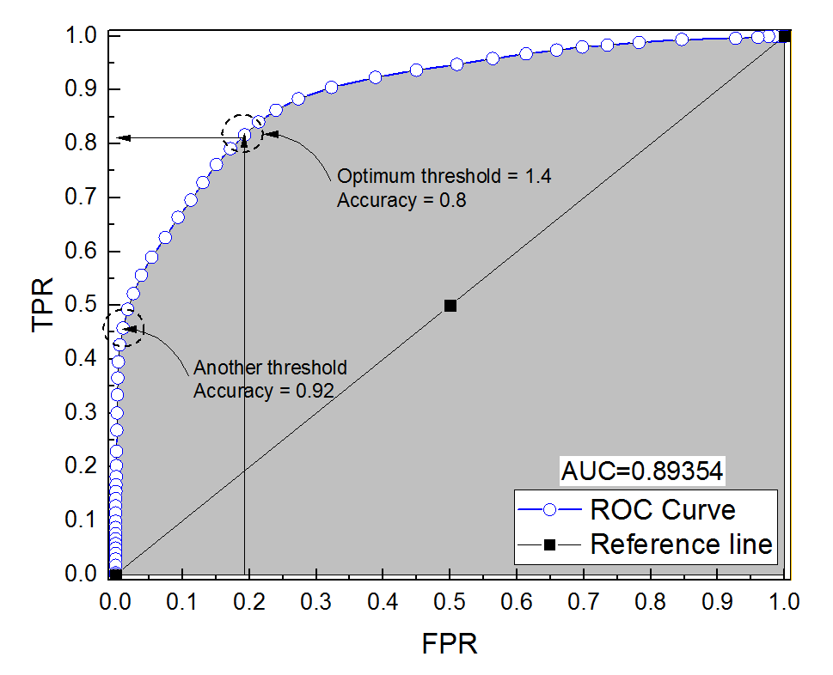
ROC curve (Receiver Operating Characteristic) and ROC-AUC score
Summarizes the model’s performance by evaluating the trade offs between TPR (True Positive rate) and FPR (False Positive rate) at different thresholds.

Slide 13
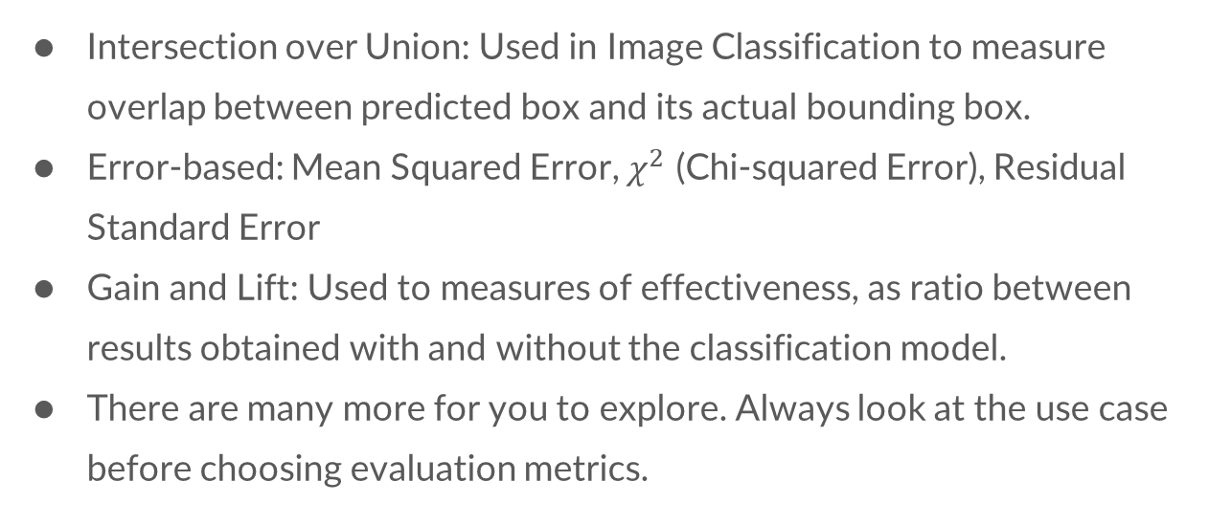
Metrics commonly used
Intersection over Union: Used in Image Classification to measure overlap between predicted box and its actual bounding box.
Error-based: Mean Squared Error, $χ^{2}$ (Chi-squared Error), Residual Standard Error
Gain and Lift: Used to measures of effectiveness, as ratio between results obtained with and without the classification model.
There are many more for you to explore. Always look at the use case before choosing evaluation metrics.

Slide 14
Implementation on Google Colab
Objective 1: Explore the Titanic passenger survival dataset on Kaggle.com
Objective 2: Train a Linear Binary classification model to predict whether a passenger survives or not.
Objective 3: Use 80-20 spilt technique and evaluate your model on the 20% test data using e

Slide 15
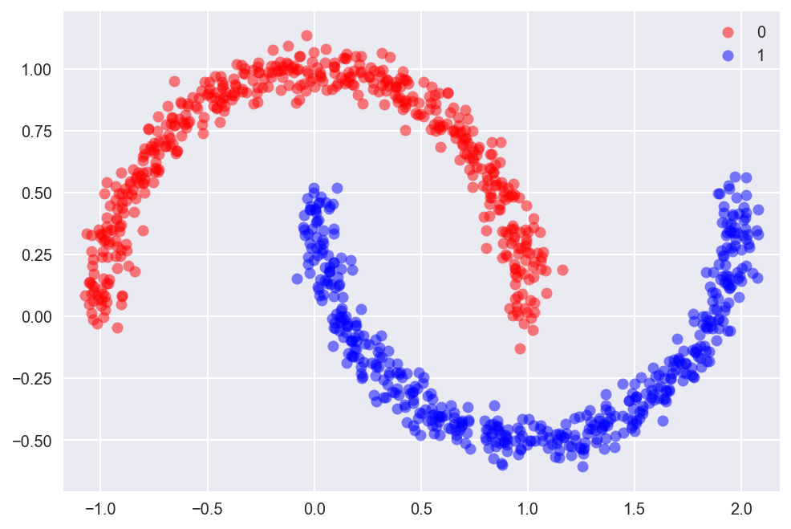
Pros and Cons of Logistic regression
Advantages:
Easy to understand and easy to train
Performs well when the dataset is linearly separable
High interpretability
Disadvantages:
Not suitable for nonlinearly separable datasets
Will overfit if the number of observations is lesser than the number of features

Slide 16
Thank you!
Time for the practicals!
DIY: Customize the Titanic dataset. This time do not exclude Name and Cabin features. Think of ways these fields can be used to improve your model.
Please share your feedback with us for this week (2mins)!

